Slide 1
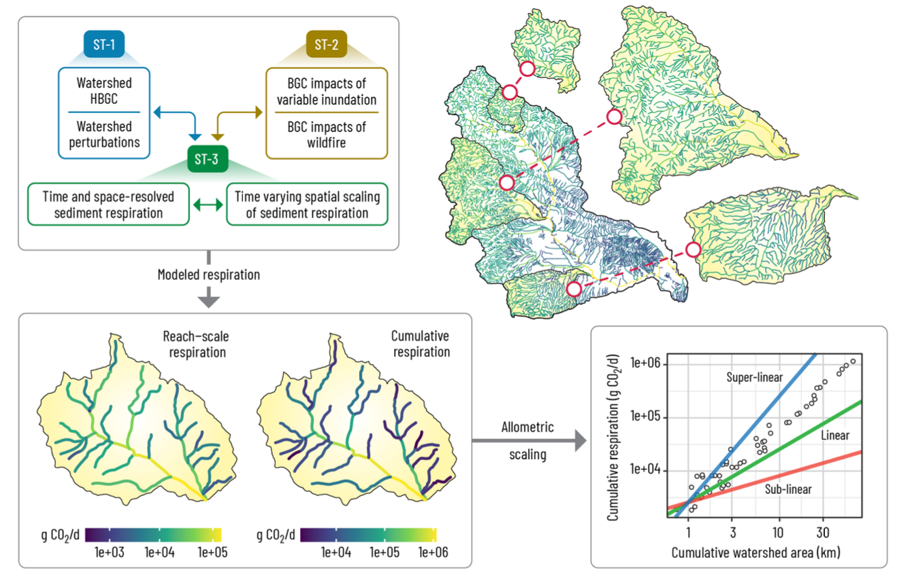
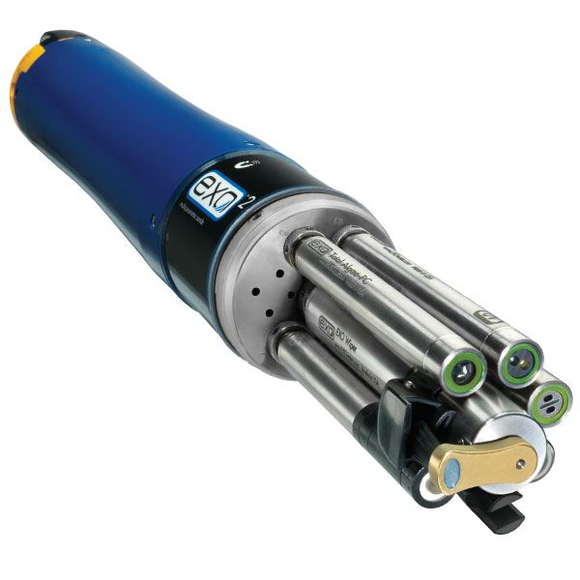
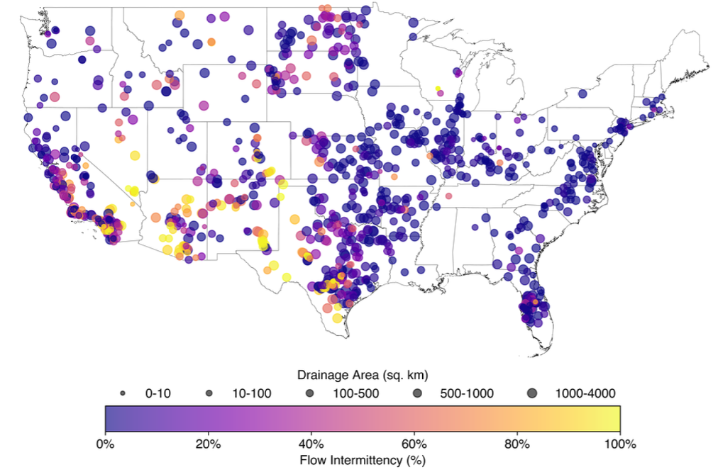
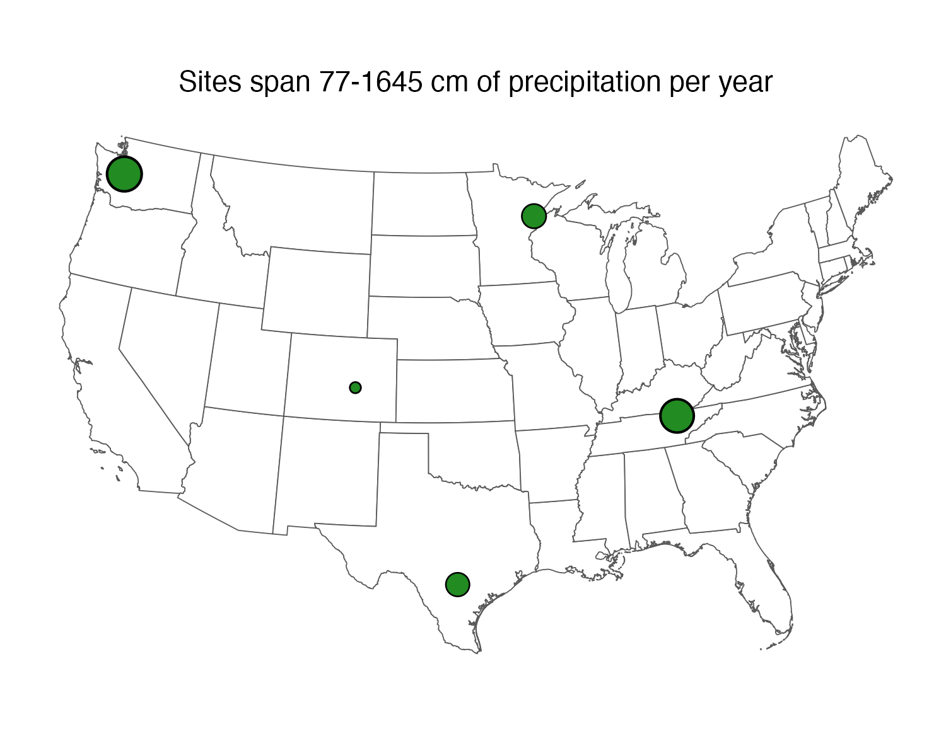
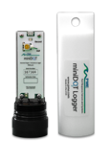
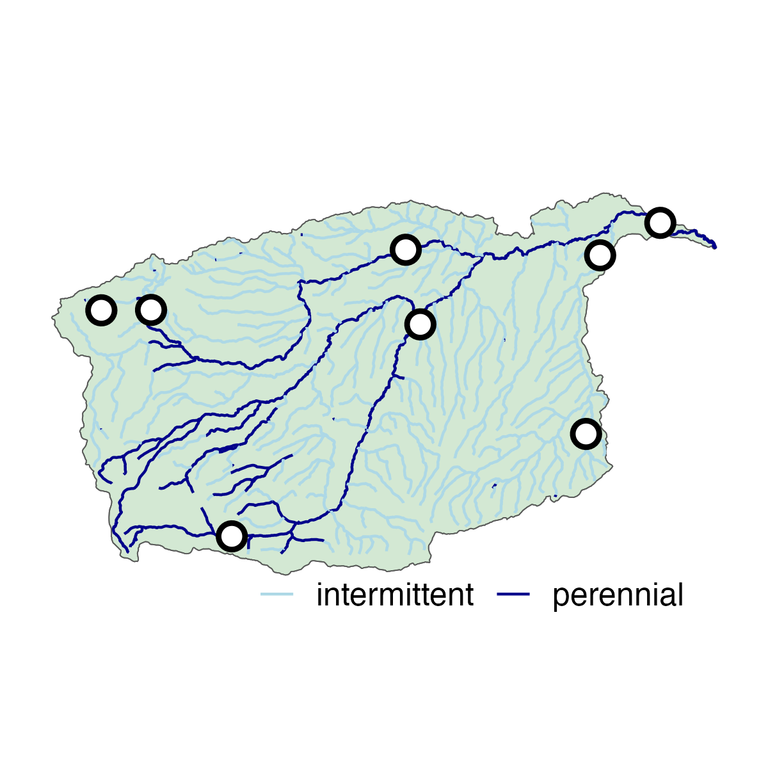
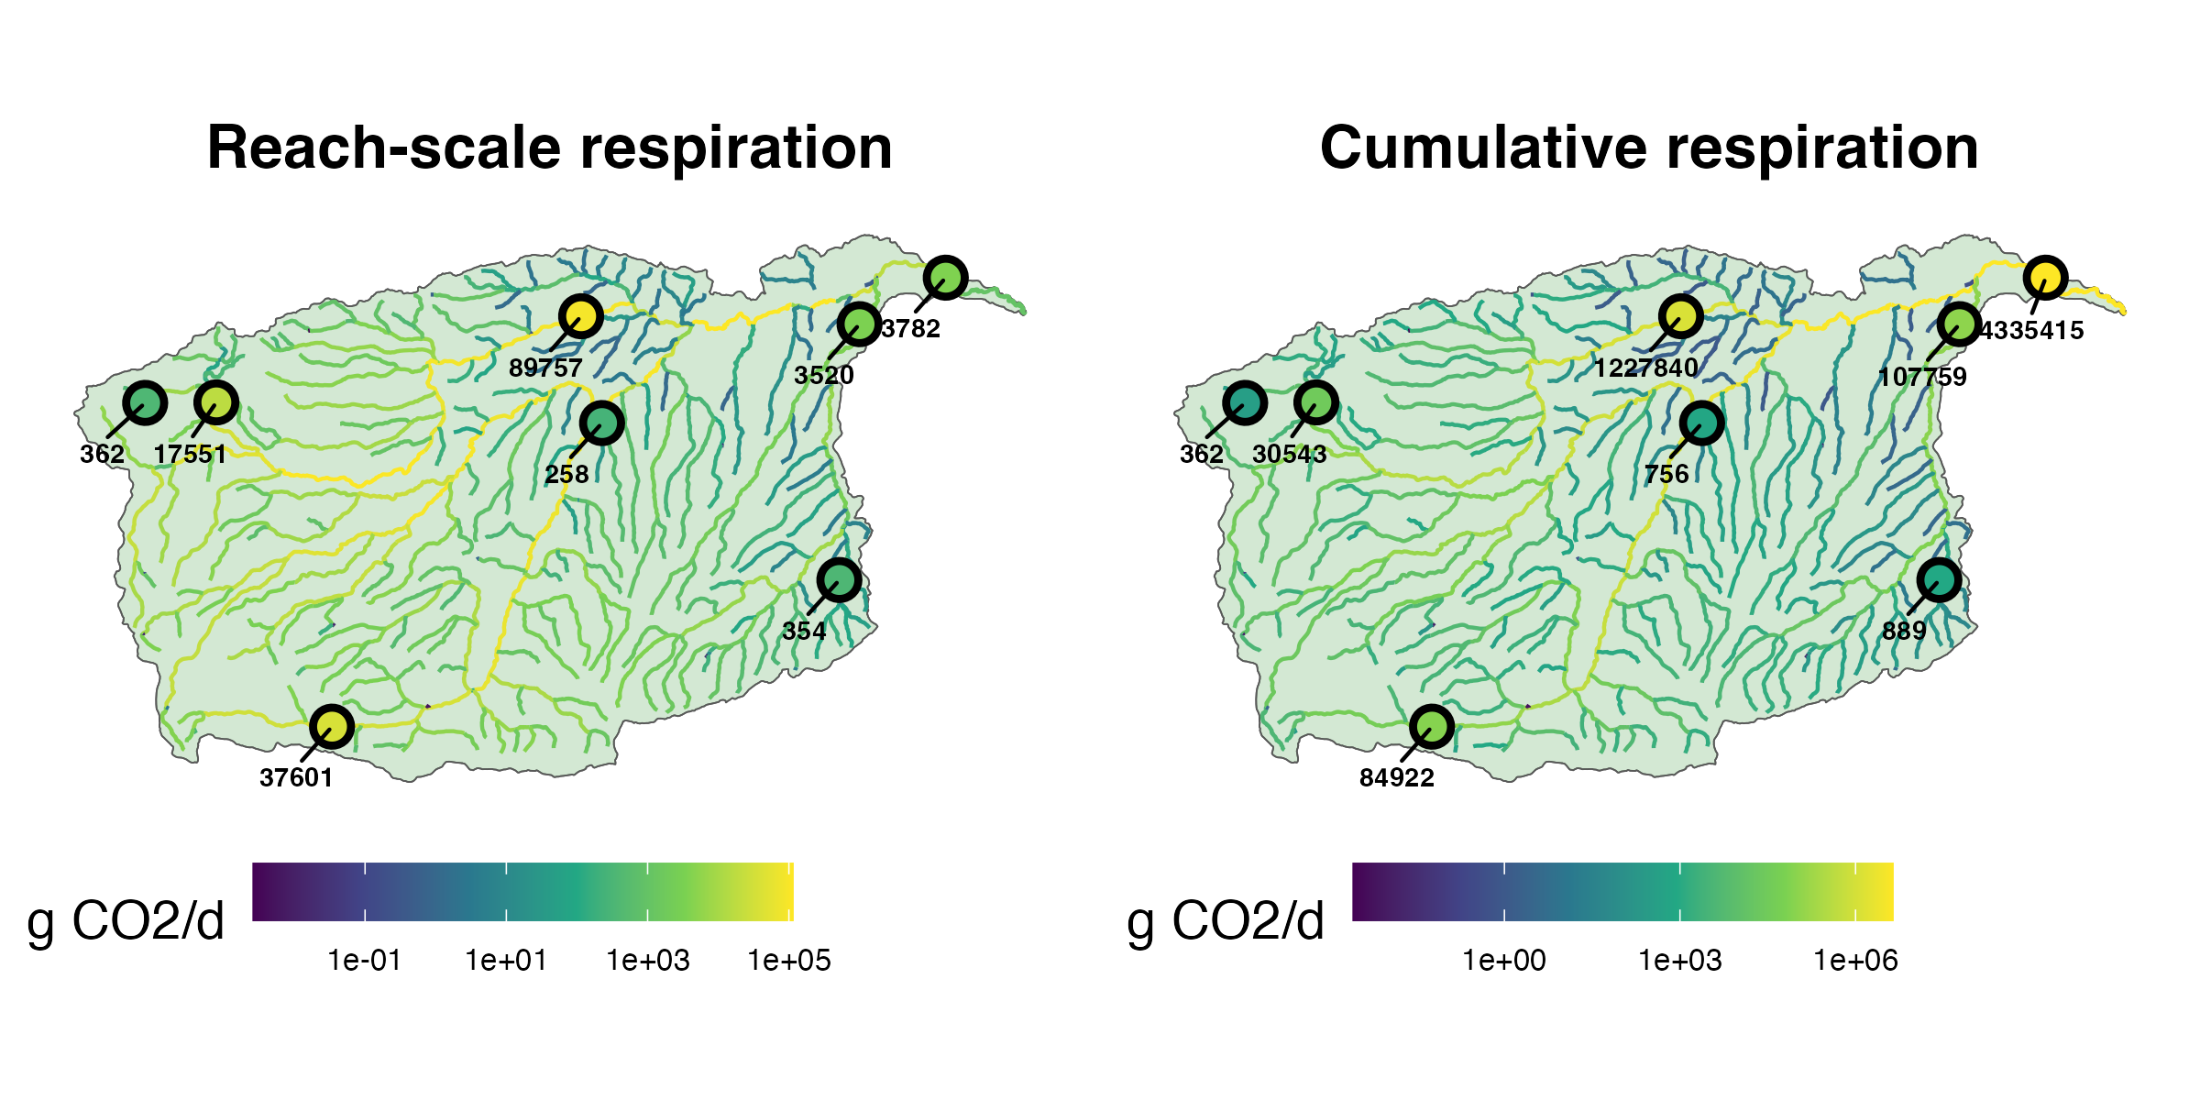
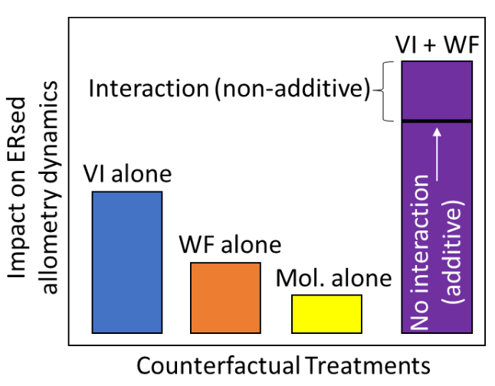
1. Knowledge transfer to ST-3B
2. Watershed and reach selection
3. Sensor deployments
4. Allometric scaling
ST-1A: watershed selection
Example: VI alone
DO and pressure at all sites
Water quality at highest-order site
streamMetabolizer
ST-3A: Perturbation
8 sites x 5 watersheds

Slide 2
Step 1: ST-1A and ST-3A inputs guide watershed selection
Step 2: Deploy sensors to measure ERsed allometric scaling
ST-1A: watershed selection
ST-3A: Perturbation
streamMetabolizer
DO and pressure at all sites
Water quality at highest-order site
8 sites x 5 watersheds
Future Modex : Model evaluation: ST-3A and ST-1A

Slide 4
